Slide 1
Data science portofolio
Dimas Baswara Pramudita

Slide 2
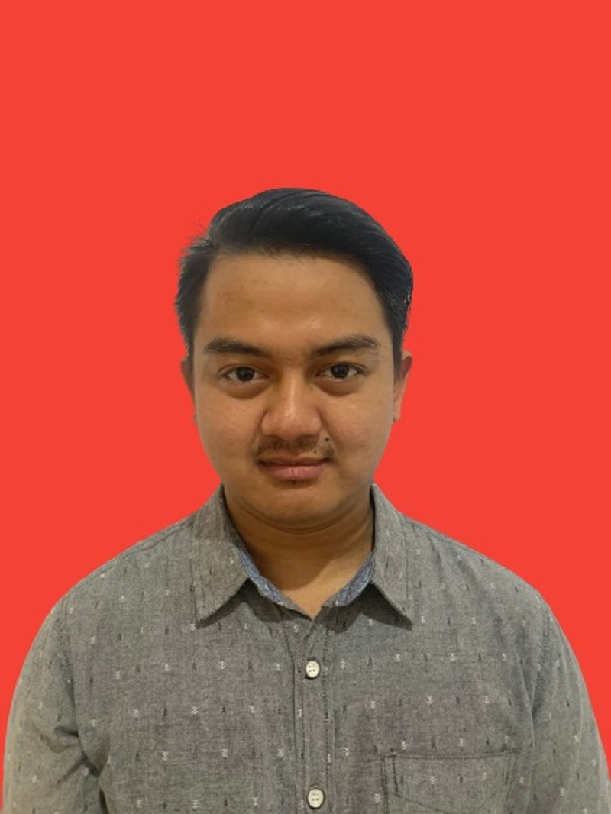
Dimas baswara pramudita
I am a self-dedicated data science enthusiast. Passionate about learning how to collect and analyze comprehensive data sets both structured and unstructured to gain insight from it that is useful for the organization. Managed to leverage data science skills that were able to find problem-solving, market research, and strategic plan to improve organization performance as a data scientist.

Slide 3
education
Binus university
(2021 – 2023)
Manajemen bisnis
Dibimbing.id
(2022 – 2023)
Data science
PPIC
(2017 – 2020)
Manajemen penerbangan
Binar academy
(2022)
Data science

Slide 4
skills
certificates
python
Data science batch 16
Dibimbing.id
Sql query
Data science batch 4
Binar academy
Machine learning
Intro to data analytics
revou
Data visualizationn
Profiency in english
schoters

Slide 5
projects
Telcom customer churn
Airlines customer segmentation
Health insurance cross-sell prediction

Slide 6
Health Insurance Cross Sell Prediction
Dimas Baswara Pramudita

Slide 7
TABLE OF CONTENTS
conclusions
Data process
Goals & solutions
Exploratory Data analysis
01
02
03
04

Slide 8
Data process

Slide 9
How to process the data ???
Data understanding & cleaning
modelling
Use case
Eda &
preprocessing

Slide 10
Use case : cross sell prediction
Objective
statement
benefit
challenge
Methodo
logy
Expected
outcome

Slide 11
Objective statement
gain 'business insight' from consumer behavior
Cross sell prediction
effective marketing

Slide 12
Business benefit
increase company profits
discover the target customer
Service excellent
Customer loyalty
01
02
03
04

Slide 13
challenge
broad demographic data
Imbalance
data
Big data

Slide 14
methodology
descriptive analysis
chart
analysis
Machine learning
model

Slide 15
Expected outcome
insurance
COMPANY
gain 'business insight' from consumer behavior based on data to predict and increase cross selling

Slide 16
Data understanding and cleaning
Data description
id: Unique ID for the customer
Gender: Gender of the customer
Age: Age of the customer
Driving_License 0 : Customer does not have DL, 1 : Customer already has DL
Region_Code: Unique code for the region of the customer
Previously_Insured 1 : Customer already has Vehicle Insurance, 0 : Customer doesn't have Vehicle Insurance
Vehicle_Age: Age of the Vehicle
Vehicle_Damage 1 : Customer got his/her vehicle damaged in the past. 0 : Customer didn't get his/her vehicle damaged in the past.
Annual_Premium : The amount customer needs to pay as premium in the year
PolicySalesChannel: Anonymized Code for the channel of outreaching to the customer ie. Different Agents, Over Mail, Over Phone, In Person, etc.
Vintage: Number of Days, Customer has been associated with the company
Response 1 : Customer is interested, 0 : Customer is not interested

Slide 17
Data cleaning
Check missing
value
There is no missing values in these case
Check duplicated
value
Drop unnecesary
columns
There is no duplicated values in these case
Drop ‘id’ columns in these case

Slide 18

Exploratory data analysis & preproscesing
Exploratory data analysis :
statistical summary
data distribution
bivariate analysis
multivariate analysis
detect outlier
correlation

Slide 19
Exploratory data analysis & preproscesing
Data preprocessing :
handling outlier(optional)
features selection
features encoding
scaling
imbalance data handling(optional)
train test split

Slide 20
modelling
Make model machine learning
Model evaluation
Choose the best model
Hyperparameter tuning
01
02
03
04

Slide 21
My models
Logistic Regression
KNeighbors Classifier
XGB Classifier
01
02
03
04
05
Decision Tree Classifier
Random Forest Classifier

Slide 22
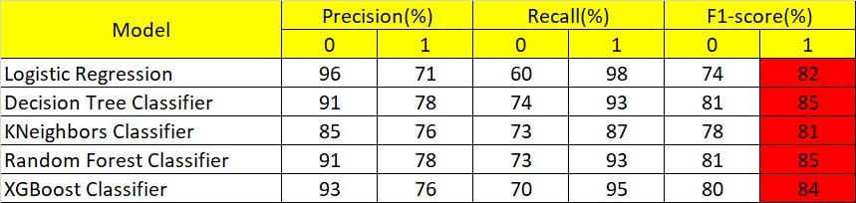
Model evaluation

Slide 23
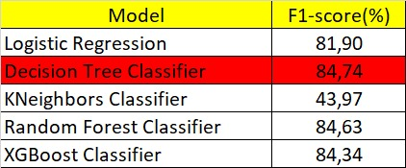
Model validation

Slide 24
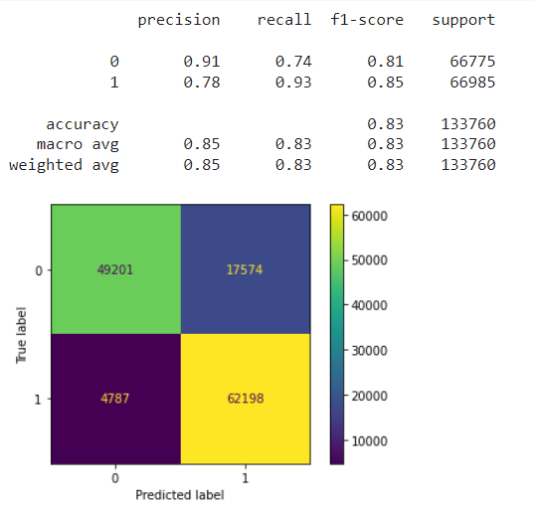
Scoring : f1 – score using decision tree classifier as the best model
insurance
COMPANY
The decision tree classifier model can predict up to 85% of customer responses interested in having vehicle insurance.

Slide 25
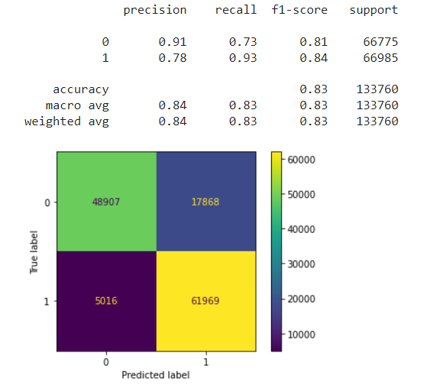
Hyperparameter tuning
insurance
COMPANY
Not always model with hyperparameter tuning better than base model. It seems like our tuning model decreased 1% than base model.

Slide 26
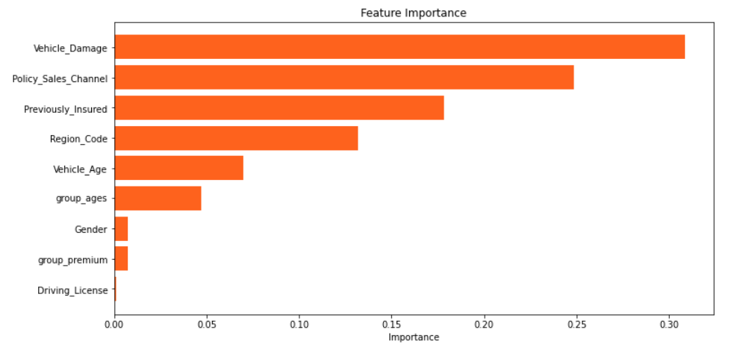
Feature importance
insurance
COMPANY
The following are features that impact machine learning models.

Slide 27
Goals and solutions

Slide 28
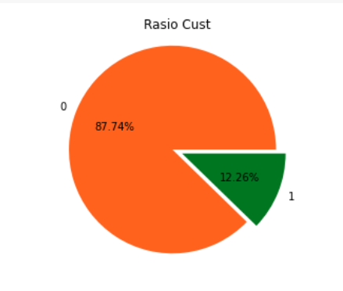
The Details
insurance
COMPANY
an Insurance company that has provided Health Insurance to its customers wants to building a model to predict whether the customers will also be interested in Vehicle Insurance provided by the company.

Slide 29
Our solutions
choose the right target group ages
choose the right Region
choose who does not have vehicle insurance before
Choose the right annual premium group
choose the right policy sales channel

Slide 30
Our solutions
better choose male than female
obviously choose those with a driving license
choose those who have vehicles that are 1 year old or even more
obviously prefer those who have experienced damage to their vehicle

Slide 31
Exploratory data analysis

Slide 32
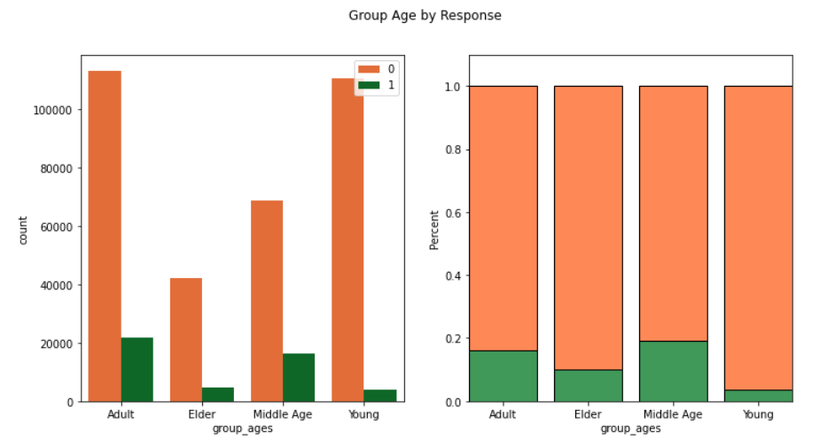
age
01
Based on graph
Adult (26 – 44 years old )
Middle Age ( 45 – 59 years old )
have a higher percentage of being attracted to vehicle insurance. Next, we will look for supporting information to support this.

Slide 33
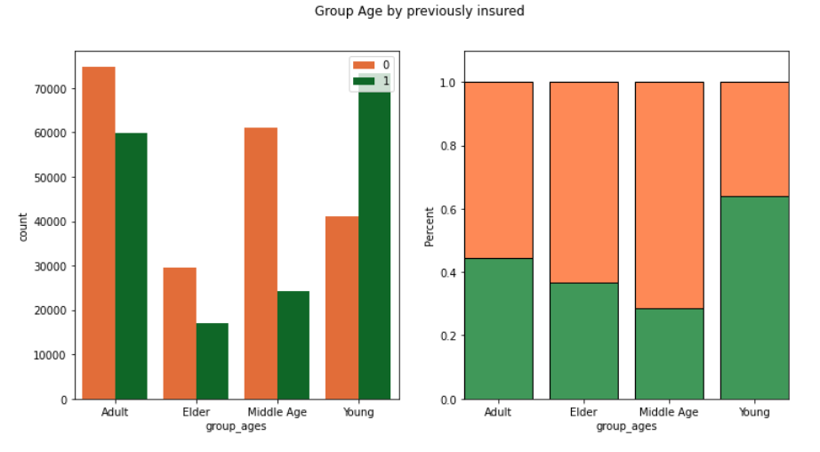
By previously insured
*
Based on graph
young ages are not interested because they already have vehicle insurance before.
On the other hand, why do middle-aged people have interest because most of them do not have vehicle insurance before.

Slide 34
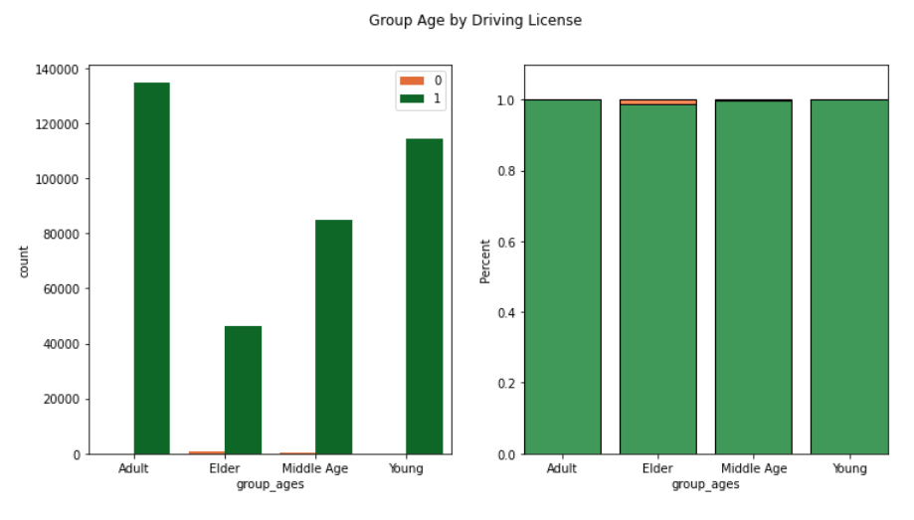
By driving license
*
Based on graph
Seems that’s why the elders are not interested because of the possibility that the elders do not all have a license to drive.

Slide 35
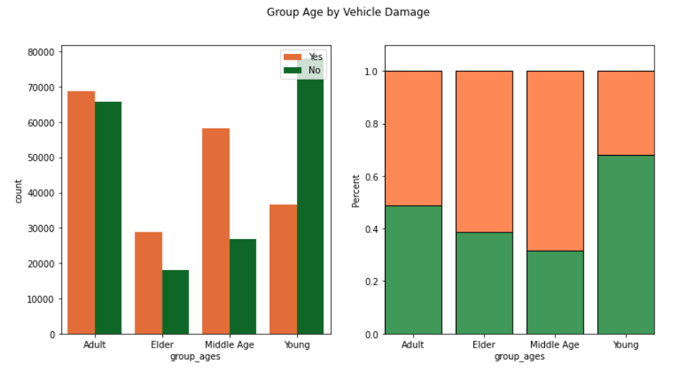
By vehicle damage
*
Based on graph
young age has more percentage to have vehicle damage but they already have vehicle insurance.
here it is known that the reason that the adult group is interested in having vehicle insurance is because they also has more percentage of vehicle damage.

Slide 36
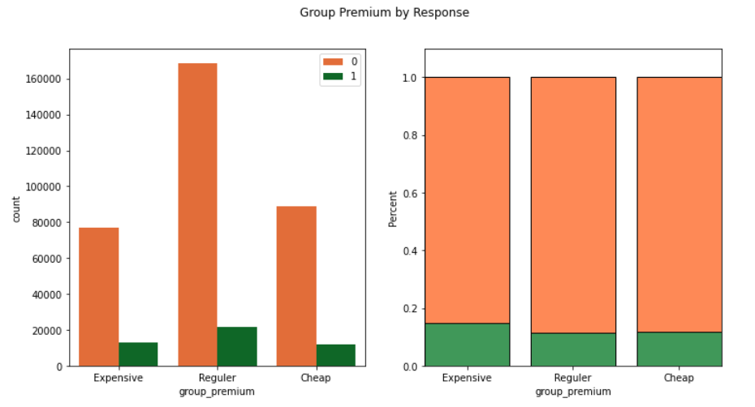
Annual premium
02
Based on graph
It can be seen that’s annual premium which is in the ‘Expensive’ category ( >= 40.000 ) have a higher percentage than others.

Slide 37
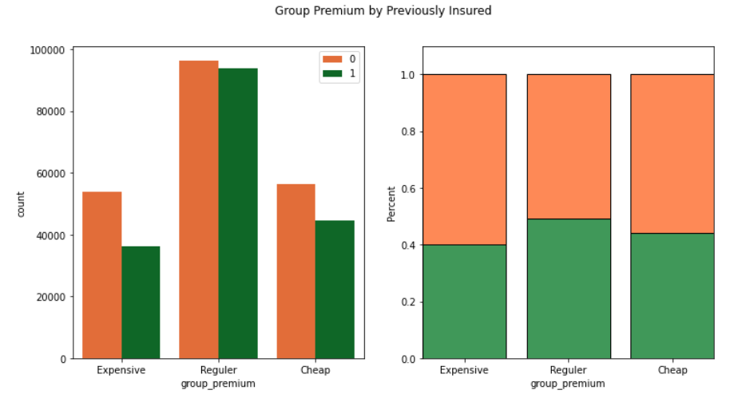
By previously insured
*
Based on graph
customers who are willing to pay more or are classified as ‘Expensive' are known not to have vehicle insurance before.
It is known, many customers who are classified as 'Regular' have vehicle insurance.

Slide 38
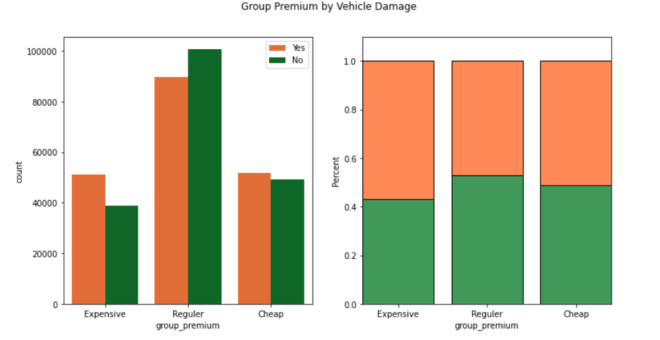
By vehicle damage
*
Based on graph
customers are in the 'Regular' category already have vehicle insurance and they also have a smaller percentage of experiencing vehicle damage.
customers who are categorized as 'Expensive' actually have a higher percentage of experiencing vehicle damage.

Slide 39
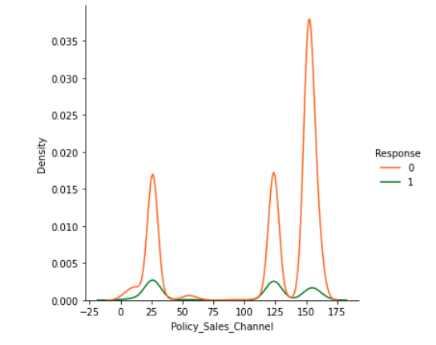
Policy sales channel
03
Based on graph
although the possibility is not big but these 3 have the performance.
24
124
152

Slide 40
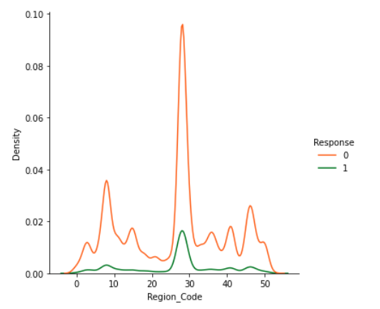
Region code
04
Basen on graph
although the possibility is not big but these region code 30 have the performance.

Slide 41
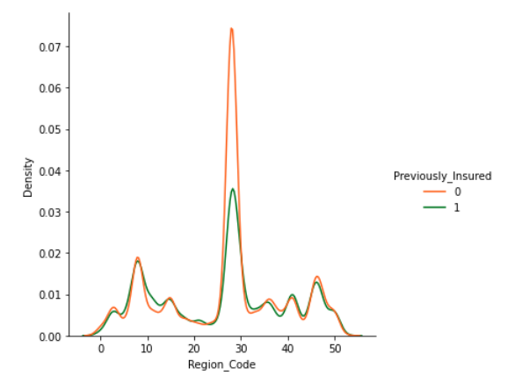
By previously insured
*
Based on graph
region codes that do not yet have vehicle insurance before are in region codes :
28
8
46

Slide 42
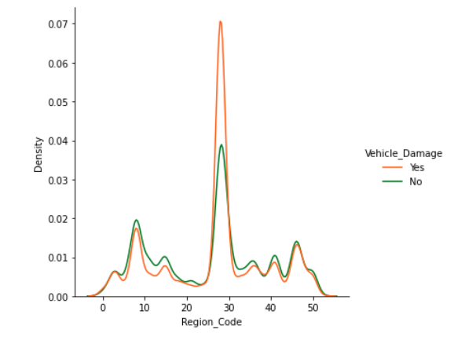
By vehicle damage
*
Based on graph
region codes that do not yet have vehicle damage before are in region codes :
28
8
46

Slide 43
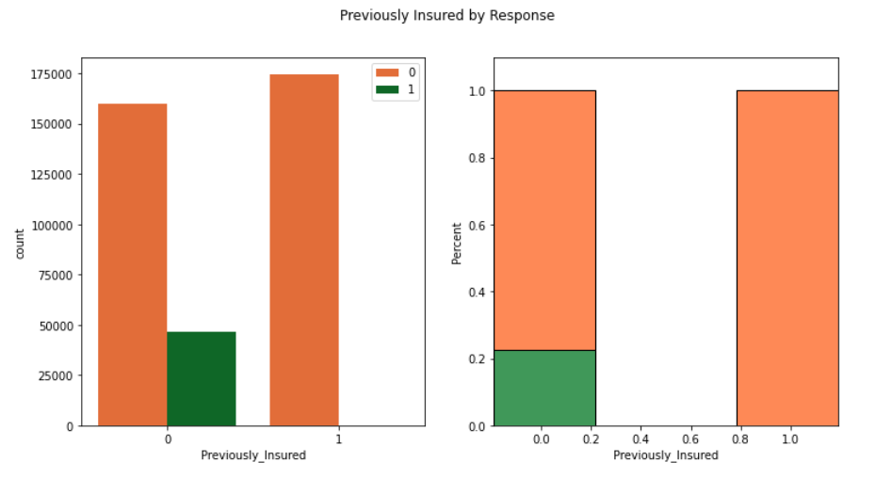
Previously insured
05
Based on graph
It can be seen that people who have not had vehicle insurance before have a higher percentage to join.

Slide 44
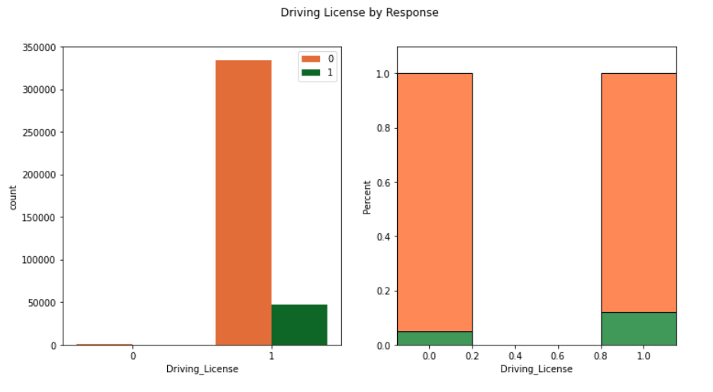
Driving license
06
Based on graph
It can be seen that people who had driving license have a higher percentage. And also, maybe who didn’t have driving license is elder.

Slide 45
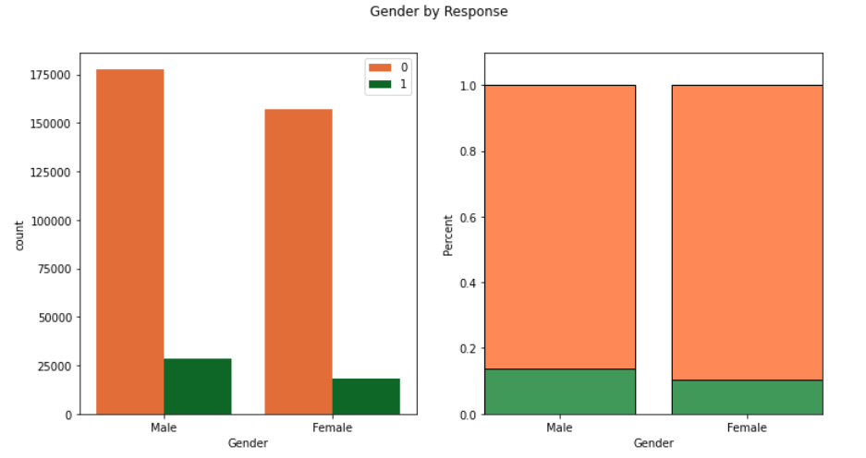
gender
07
Based on graph
It can be seen that people who are male have a higher percentage than female.

Slide 46
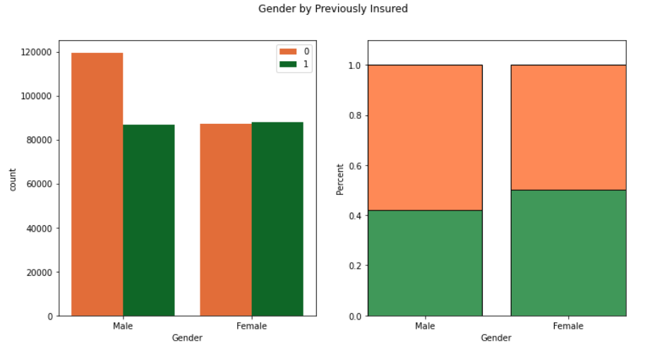
By Previously insured
*
Based on graph
It can be seen, that is why have to choose male than female because female had higher percentage to insured their vehicle before.

Slide 47
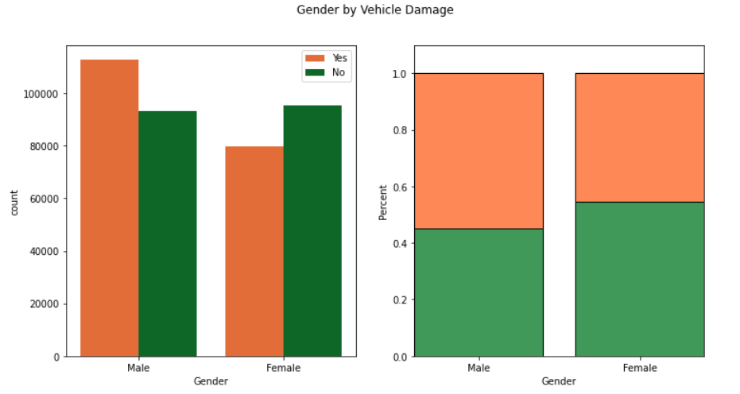
By Vehicle damage
*
Based on graph
even if women have a higher percentage of sustaining damage to their vehicle, they already have vehicle insurance before.
the percentage of 'male' experiencing damage is smaller but they doesn’t have vehicle insurance before.

Slide 48
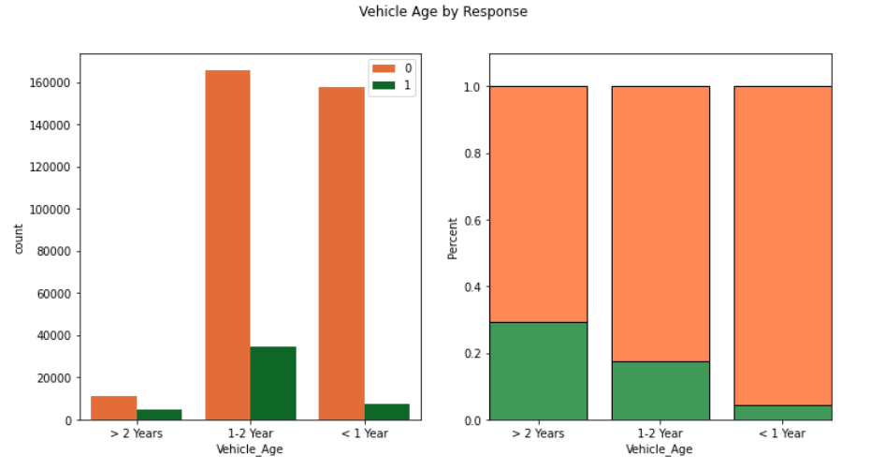
Vehicle age
08
Based on graph
It can be seen that’s vehicles that are over 1 year old have a higher percentage than vehicles that are less than 1 year old.

Slide 49
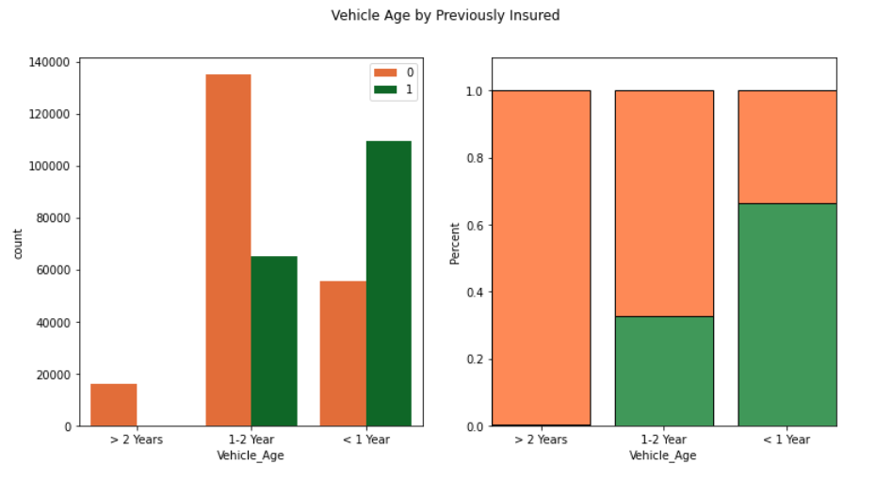
By Previously insured
*
Based on graph
vehicles that are less than 1 year old already have vehicle insurance.
vehicles that are 1-2 years old have previous vehicle insurance but less.
vehicles that are more than 2 years old do not have previous vehicle insurance.

Slide 50
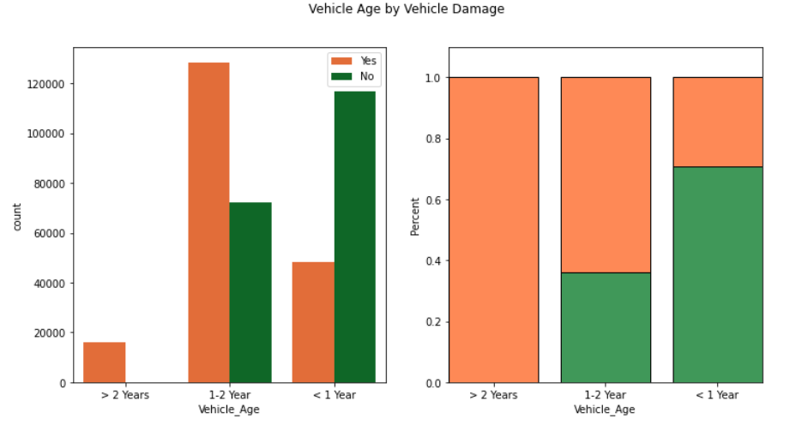
By Vehicle damage
*
Based on graph
However, vehicles that are less than 1 year old experience more vehicle damage.
vehicles that are 1-2 years old have experienced vehicle damage but less.
it's better if vehicles that are more than 2 years old rarely experience vehicle damage and it's more profitable if you can get a customer like this.

Slide 51
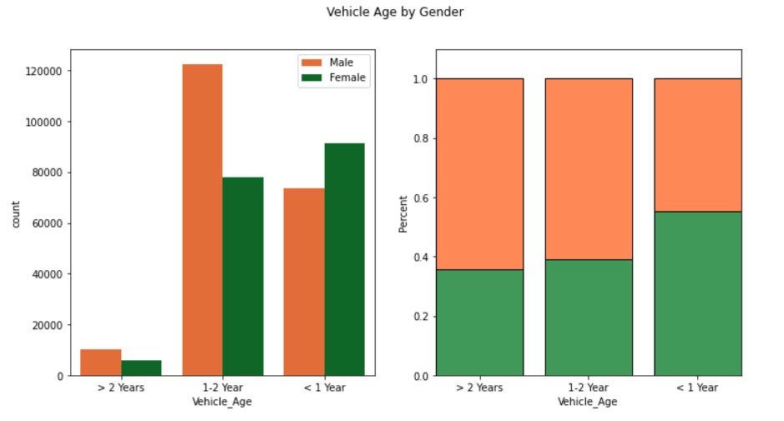
By gender
*
Based on graph
female are more dominant in owning new vehicles.
more male have vehicles aged from 1 year or more.
That’s why better choose male than female.

Slide 52
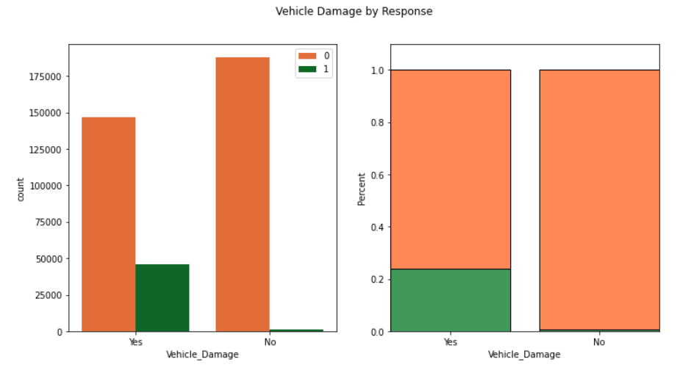
Vehicle damage
09
Based on graph
It can be seen that people who have had vehicle damage before have a higher percentage.

Slide 53
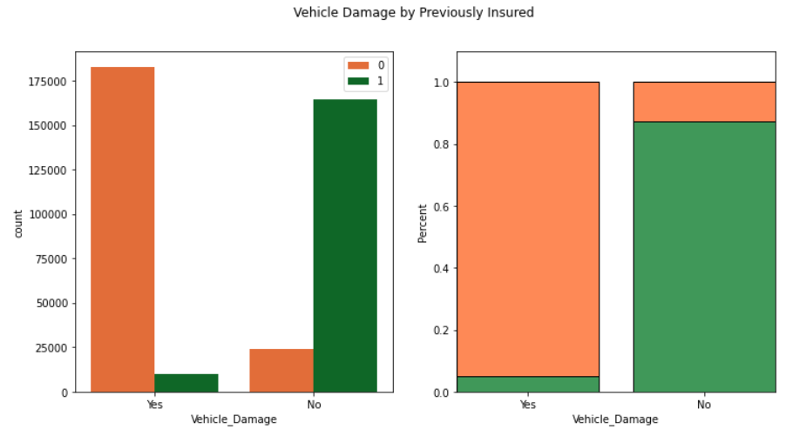
By Previously insured
*
Based on graph
It can be seen that people who have had vehicle damage before they didn’t have vehicle insurance before.

Slide 54


conclusions
In conclusion, the insurance industry is a competitive market, and it provider must have a strategic plan in their approach to sales and marketing in order to succeed. By understanding the patterns in customer behaviour it can produces business insight that help company in making decision wisely. Therefore, business insight in this project offer valuable insights into how the company can effectively targeting their potential customer, improve sales, and profit for company.

Slide 55


Thanks !
Here it’s my notebook for detail?
https://github.com/dimasbaswara81/Customer-Churn

